Slide 1
How Can Gov. Insts. Communicate Better on Human Rights?
Peyman Pejman
PeymanPejman@Hotmail.com
WhatsApp: +33 7 86 05 08 06

Slide 2
How Can Gov. Insts. Communicate Better on
Human Rights?
In this presentation:
--Why there is a need to re-examine communications on HR
--How Line Ministries and Depts currently handle communications
--Ways to improve communications
--(Day 2) Some collectives and hands-on exercises

Slide 3
How Can Gov. Insts. Communicate Better on Human Rights?
Why is There A Need?
First, why we do we need to discuss this issue? Why is it important to look at how ministries and departments communicate on Human Rights?
Notes:
And before I start, pls accept my assurances that NONE of this is meant as a criticism of anyone or any entity. If you disagree with what I am saying pls say so and let’s discuss it. We have put aside time for discussion

Slide 4
How Can Gov. Insts. Communicate Better on Human Rights?
Why Is There A Need?
Primarily two reasons:
1-The Nature of Human Rights Discussions in Georgia
2-How government ministries & departments typically function

Slide 5
How Can Gov. Insts. Communicate Better on Human Rights?
Why Is There A Need?
Nature of HR Discussions in Georgia:
--Systematic application of Human Rights itself is a relatively new sphere of operations for the government
--Human Rights are often discussed from a political perspective
--There is a widespread perception that the Human Rights situation in the country has worsened AND that the government is not doing enough
Notes:
Notice I put perception and worsened in italic.

Slide 6
How Can Gov. Insts. Communicate Better on Human Rights?
Why Is There A Need?
Lack of a systematic implementation of Human Rights has had primary consequences:
1-Well-meaning and hard-working as you are, there seems to be little coordination within and intra ministries-department on HR. Lack of strategic action
2-Countrywide dissemination of information has been uneven
3-And, consequentially, communications about HR has been uneven and left to individual relevant ministries and departments
Notes:
I will show what I mean shortly

Slide 7
How Can Gov. Insts. Communicate Better on Human Rights?
Why Is There A Need?
--Human Rights have become entangled in Georgia’s politics
-Every country has a “past,” “baggage”
-Once you look at Human Rights from the prism of political ideologies, it becomes that much harder to communicate effectively
-For most effective communication, you’d need to look at it as a national/societal issue that involves everyone

Slide 8
How Can Gov. Insts. Communicate Better on Human Rights?
Why Is There A Need?
Four years after the adoption of the National Human Rights Strategy, 87 percent of Georgians say they have not heard of the Strategy or the Action Plan. Sixty-one percent say they are either “uninformed or slightly informed” about human rights and their protection mechanisms in Georgia.
About 50 percent of the eligible voters cast their ballots in the first round of the presidential elections this year. That means half the country is still a willing participant in the political process, which, obviously, includes their human rights! Read: Opportunity!!

Slide 9
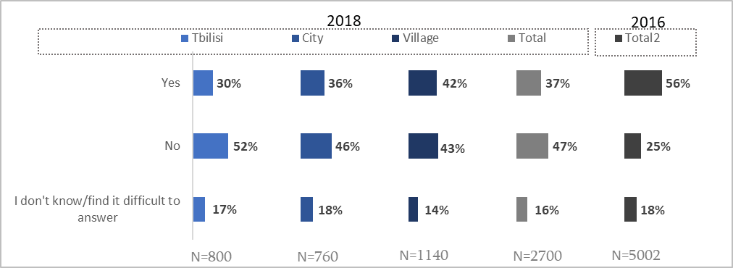
How Can Gov. Insts. Communicate Better on Human Rights?
Why Is There A Need?
Chart # 11 Do you think that the state is oriented toward enhancing human rights protection?

Slide 10
How Can Gov. Insts. Communicate Better on Human Rights?
Why Is There A Need?
Chart # 12 How would you evaluate the quality of human rights protection in Georgia for now?

Slide 11
How Can Gov. Insts. Communicate Better on Human Rights?
Why Is There A Need?
Typical Gov Communications Operations:
The best way for an entity, government or private sector, to do communications is AFTER the bosses have identified clear goals, missions, and target audience for their operations
Sadly, that rarely happens!! In our context, Human Rights have NOT been identified as a priority. Proof?

Slide 12
How Can Gov. Insts. Communicate Better on Human Rights?
Why Is There A Need?
Before we get to how government institutions in Georgia currently handle communications issues in general, and Human Rights topic in particular, let’s look at some terms we commonly use in the field and go over their definitions. That will help later in having unified concepts about communicating

Slide 13
How Can Gov. Insts. Communicate Better on Human Rights?
Let’s start with a few nitty-gritty definitions! ☺
Communication:
How would you define “communication”?
Communications:
How is that different from the above?

Slide 14
How Can Gov. Insts. Communicate Better on Human Rights?
Nitty-Gritty Definitions (2)
Public Affairs:
Versus
Public Relations:

Slide 15
How Can Gov. Insts. Communicate Better on Human Rights?
Nitty-Gritty Definitions (3)
Last but not least (which is why I put it in a slide by itself)
Strategic Communication

Slide 16
How Can Gov. Insts. Communicate Better on Human Rights?
Nitty-Gritty Definitions (4)
Communication:
The imparting or exchanging of information by speaking, writing, or using some other medium(Merriam-Webster Dictionary)
Two-way process of reaching mutual understanding, in which participants not only exchange (encode-decode) information, news, ideas and feelings but also create and share meaning (Business Dictionary)
Communications:
All of the above, but this includes the means with which we share the above
Notes:
Communications: impact of technology

Slide 17
How Can Gov. Insts. Communicate Better on Human Rights?
Nitty-Gritty Definitions (5)
Public Affairs:
Public Affairs is more like “Communication”. It is about conveying information about anything from legislation and policy to products to the public. It is meant to be more short term, without necessarily meaning to “impact”
Public Relations:
While more of a marketing and advertising term, it also applies very much to government operations. This is where you build relations with your “targeted” community/(ies) to formulate an opinion in them. It is meant to be long(er) term

Slide 18
How Can Gov. Insts. Communicate Better on Human Rights?
Nitty-Gritty Definitions (6)
Strategic Communication:
Purposeful use of communication by an organization to fulfill its mission
(International Journal of Strategic Communication)
Strategic communication can mean either communicating a concept, a process, or data that satisfies a long term strategic goal of an organization by allowing facilitation of advanced planning, or communicating over long distances ….. It can also mean the related function within an organization, which handles internal and external communication processes. (Wikipedia, compiled from various academic sources)

Slide 19
How Can Gov. Insts. Communicate Better on Human Rights?
Why Is There A Need
Let’s go back to the slide where we mentioned:
2-How government ministries & departments typically function
The next dozen or so slides show how government ministries currently present their communication effort
This is a mini-exercise ☺ Please study each slide carefully and discuss your impressions from the perspective of the ministry itself. We are not critiquing each other!
Notes:
I put it in bold to separate from the fact that you most probably do a lot of other stuff that is not reflected on the web

Slide 20
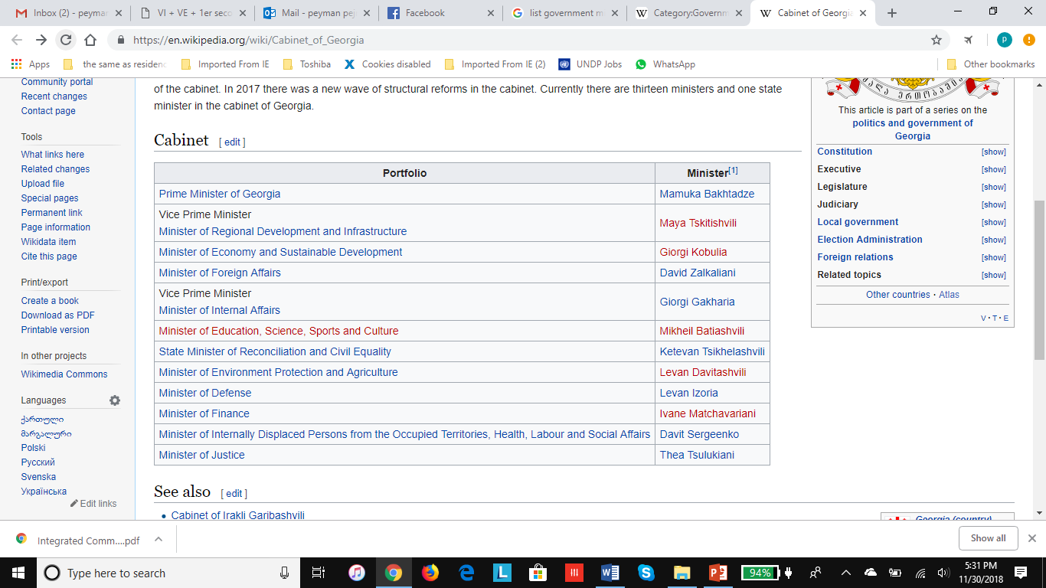
How Can Gov. Insts. Communicate Better on Human Rights?
How is communication being handled now? (1)
http://gov.ge/index.php?lang_id=ENG&sec_id=124&mod_id=0&info_id=0&new_year=0&limit=0&date=&new_month=&entrant=1
Notes:
The list does not include special departments and secretariats, such as yours

Slide 21
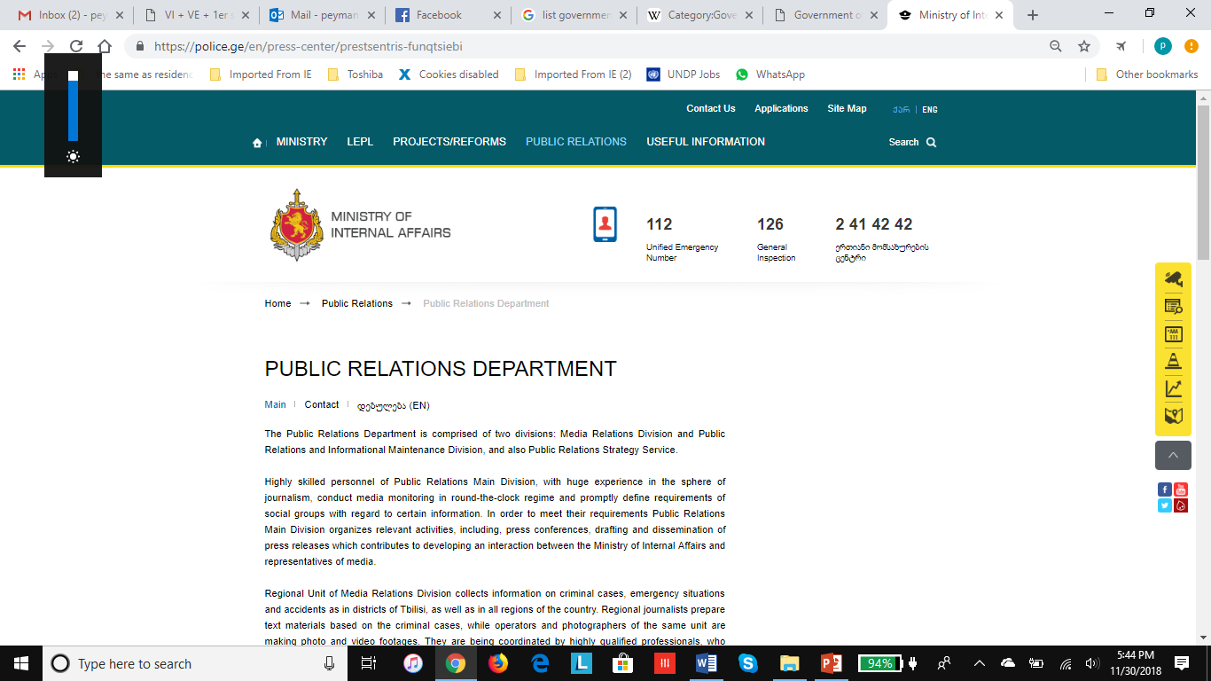
How Can Gov. Insts. Communicate Better on Human Rights?
How is communication being handled now (2)?

Slide 22
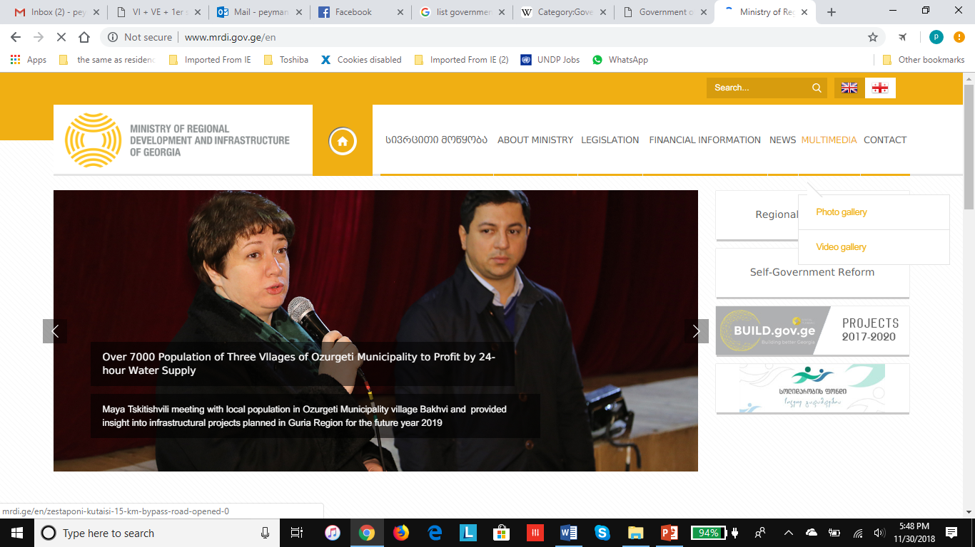
How Can Gov. Insts. Communicate Better on Human Rights?
How is communication being handled now? (3)

Slide 23
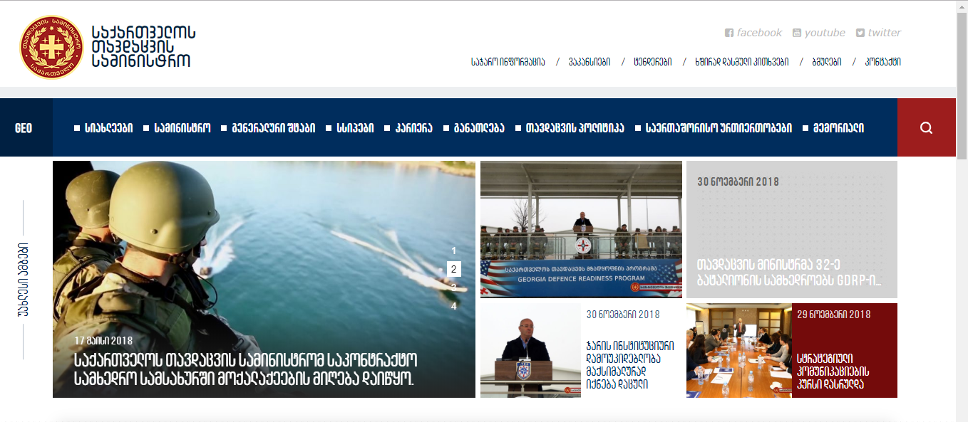
How Can Gov. Insts. Communicate Better on Human Rights?
How is communication being handled now? (4)

Slide 24
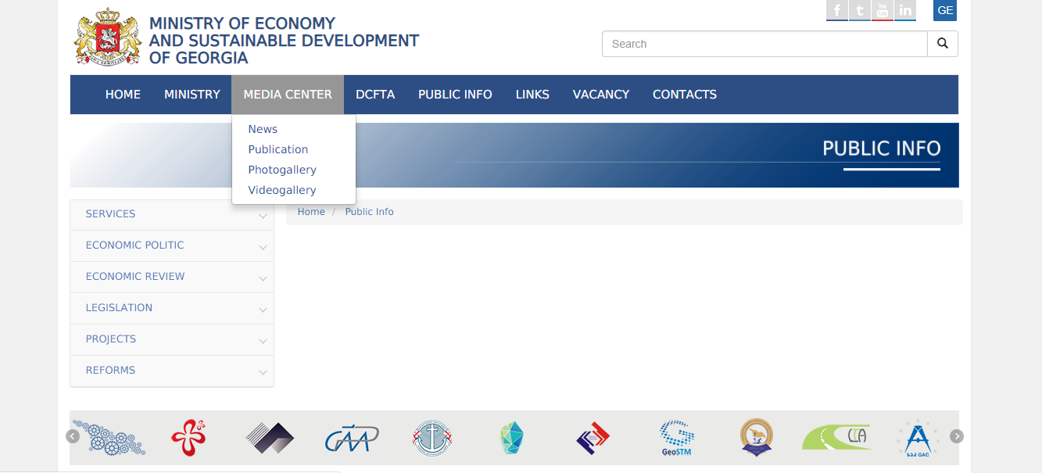
How Can Gov. Insts. Communicate Better on Human Rights?
How is communication being handled now? (5)

Slide 25
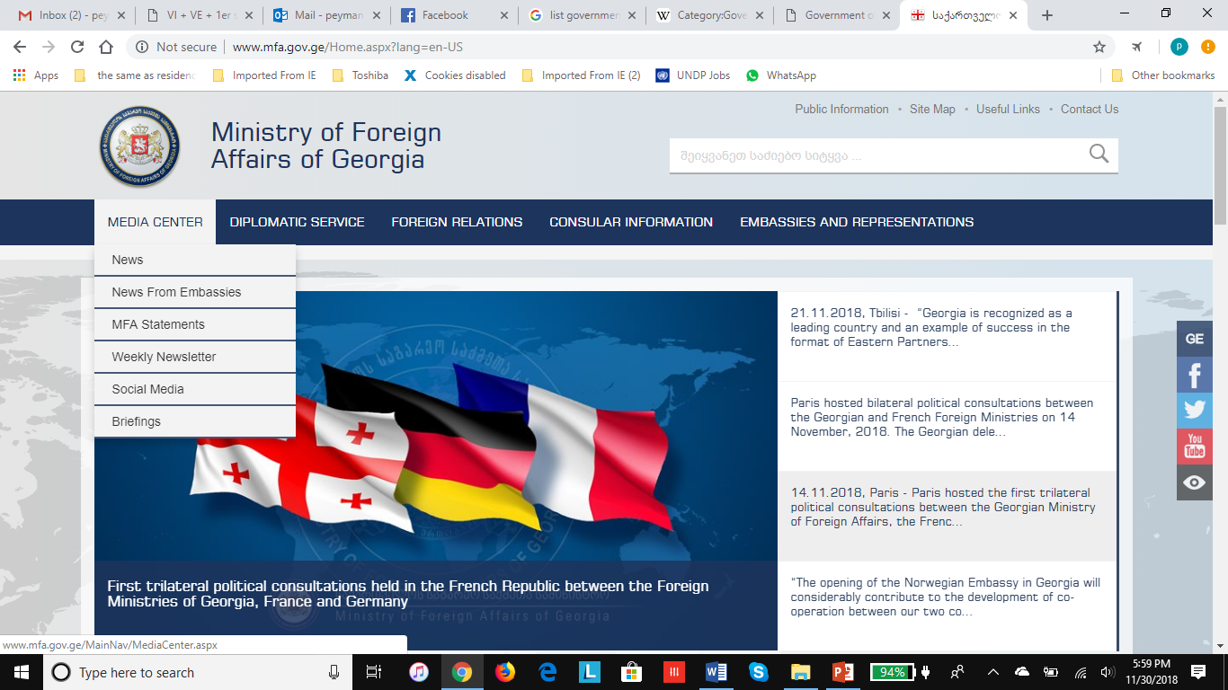
How Can Gov. Insts. Communicate Better on Human Rights?
How is communication being handled now? (6)

Slide 26
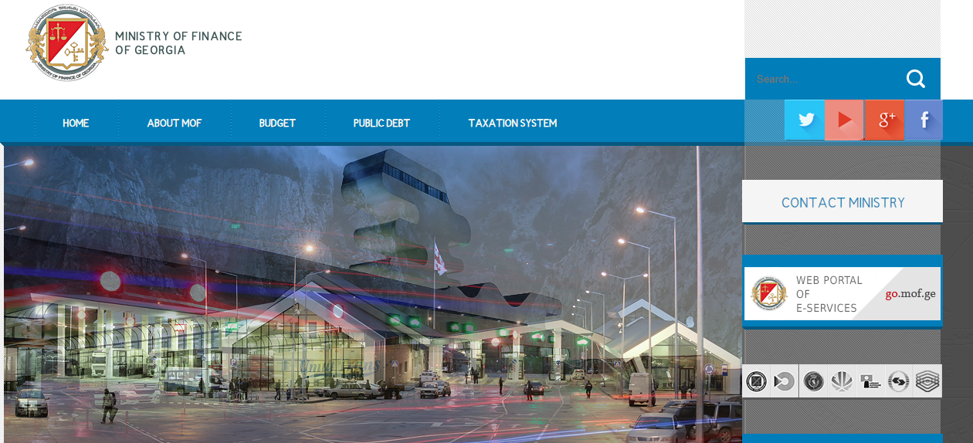
How Can Gov. Insts. Communicate Better on Human Rights?
How is communication being handled now? (7)

Slide 27
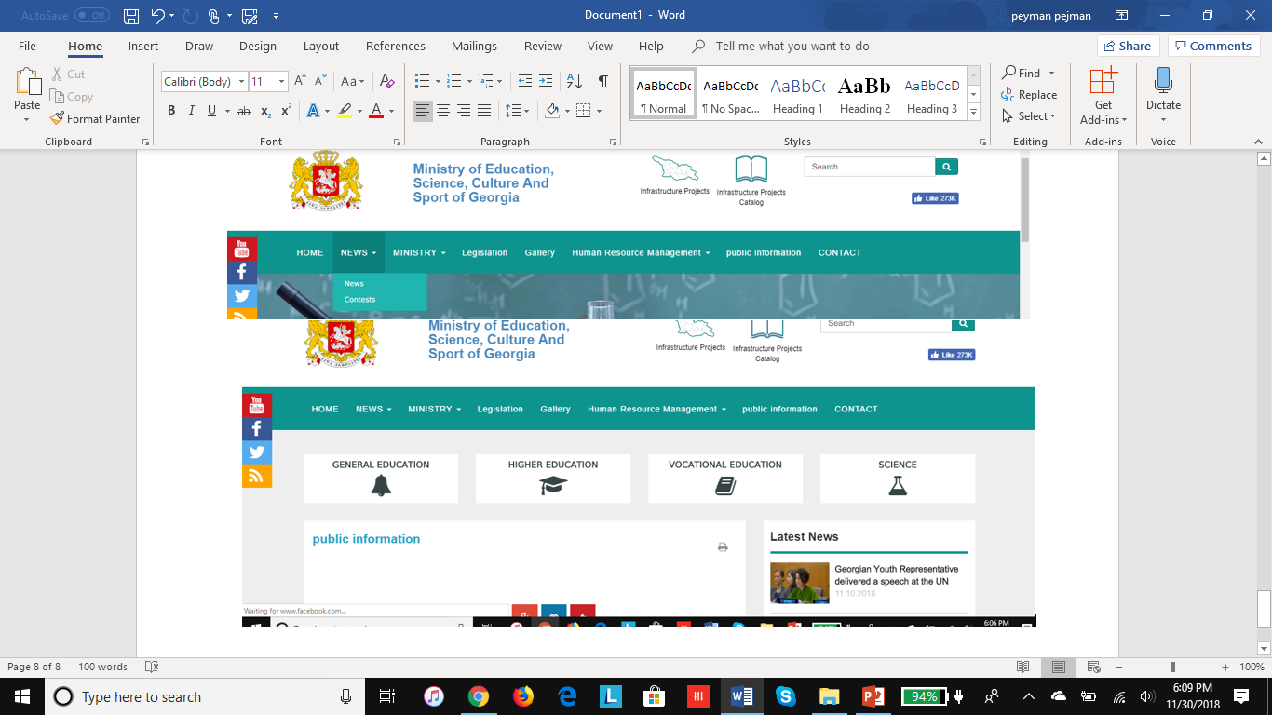
How Can Gov. Insts. Communicate Better on Human Rights?
How is communication being handled now? (8)

Slide 28
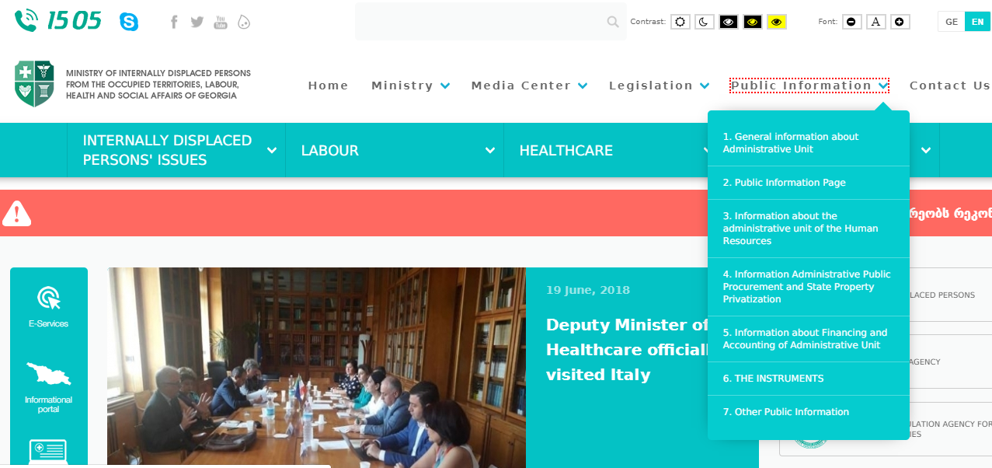
How Can Gov. Insts. Communicate Better on Human Rights?
How is communication being handled now? (9)

Slide 29
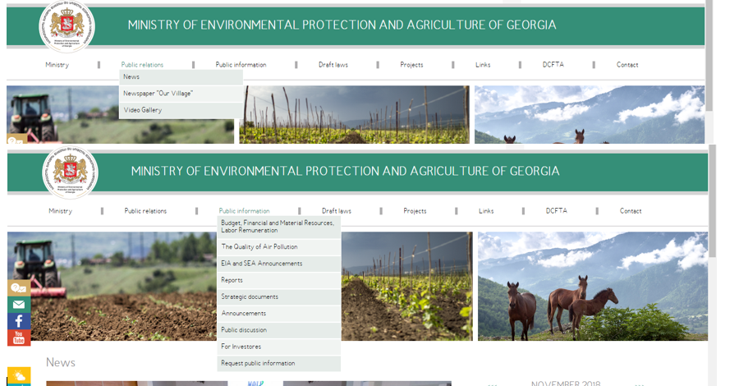
How Can Gov. Insts. Communicate Better on Human Rights?
How is communication being handled now? (10)

Slide 30

How Can Gov. Insts. Communicate Better on Human Rights?
How is communication being handled now? (11)

Slide 31
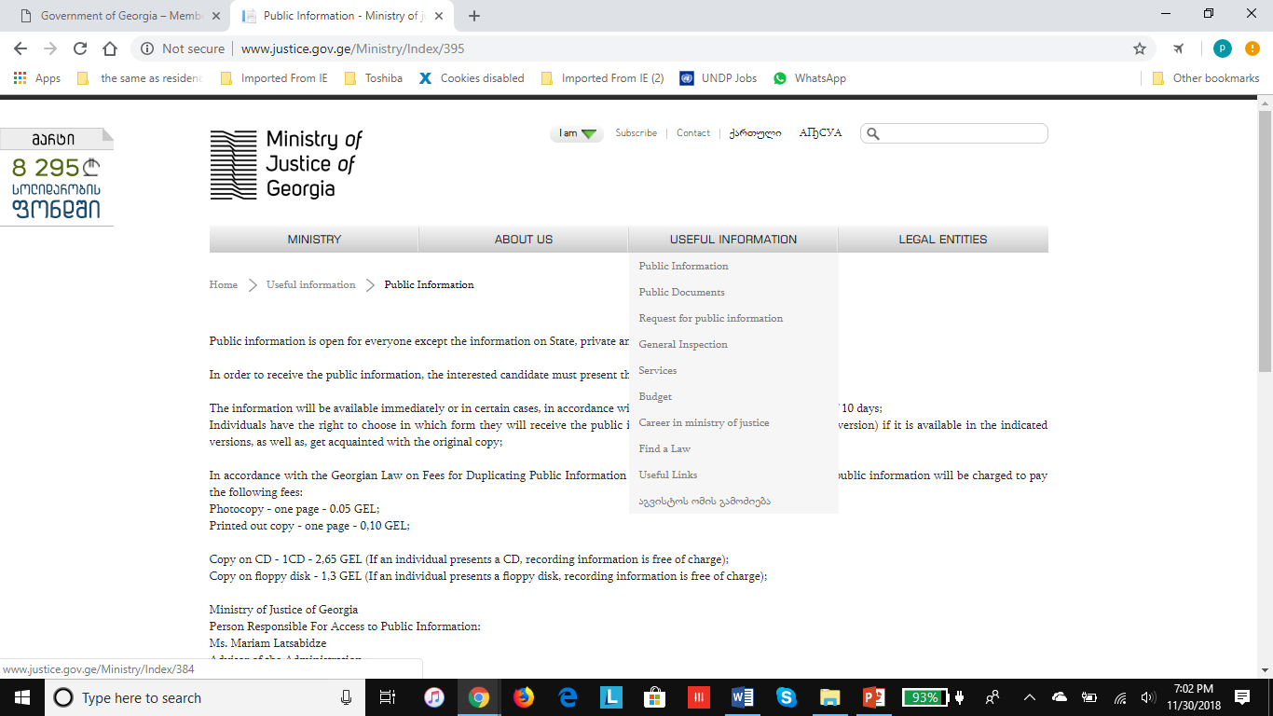
How Can Gov. Insts. Communicate Better on Human Rights?
How is communication being handled now? (12)

Slide 32
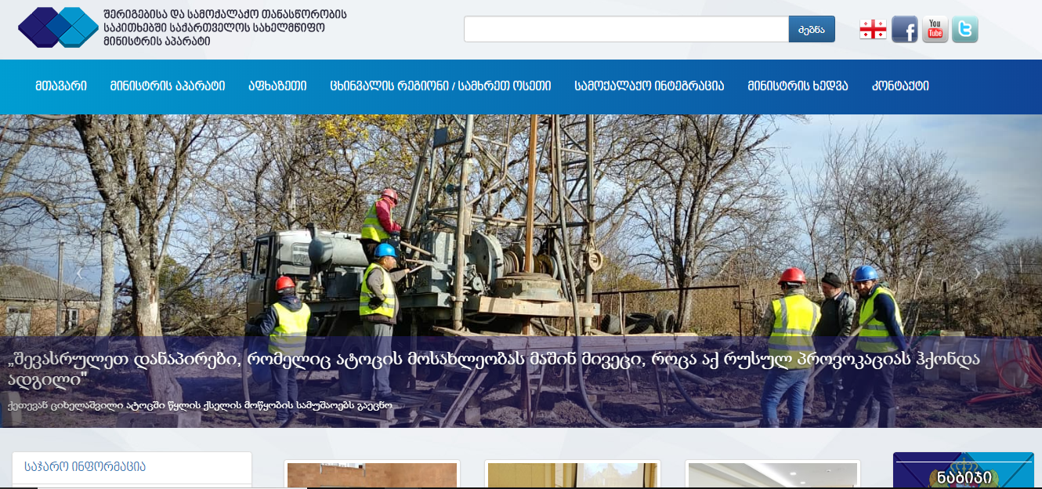
How Can Gov. Insts. Communicate Better on Human Rights?
How is communication being handled now? (13)
State Minister of Georgia for Reconciliation and Civic Equality
Notes:
None of the pages before pages says anything about human rights, either as a strategy or even in the news articles and stories on their pages. There is no focus on human rights

Slide 33

How Can Gov. Insts. Communicate Better on Human Rights?
How is communication being handled now? (14)
Notes:
Relationship between IT, Comms, management

Slide 34
How Can Gov. Insts. Communicate Better on Human Rights?
How Can You Improve Communications?
--There are two ways of looking at this:
1-How you can improve unilaterally, within the scope of your own respective ministries
2-How you can improve multilaterally, in cooperation with other entities

Slide 35
How Can Gov. Insts. Communicate Better on Human Rights?
How Can You Improve Communications?
Improving communication unilaterally
Granted, some ministries’ mandate and mission leaves more leeway for Human Rights coverage, on a unilateral basis
If so, where are the geographic distributions? How easy, difficult to get to them?
Notes:
Show of hands, pls! Let’s put on board the mission of each ministry to use later. Or if access to the internet, spend 1-15 minutes researching and then talk

Slide 36
How Can Gov. Insts. Communicate Better on Human Rights?
How Can You Improve Communications?
Improving communication unilaterally
For people to feel that your ministry cares about Human Rights, they must see that you give it more coverage and importance, not just through Internet
And for them to believe you, you MUST adhere to the fundamental rule in communication

Slide 37

How Can Gov. Insts. Communicate Better on Human Rights?

Slide 38
How Can Gov. Insts. Communicate Better on Human Rights?
How Can You Improve Communications?
But how do you keep up with the repetition process?
1-You actually need to produce more material
2-You have to use the multiplication factor. Just issuing press releases about meetings and tweeting about it will not do the job
Notes:
Ask if they know how much material they produce each month and in what forms

Slide 39
How Can Gov. Insts. Communicate Better on Human Rights?
How Can You Improve Communications?
What can you do to produce more material?
Remember, we have:
Tactical Communication
Strategic Communication
Notes:
Let’s see how remembers the definitions.

Slide 40
How Can Gov. Insts. Communicate Better on Human Rights?
How Can You Improve Communications?
What can you do to produce more material?
Let’s keep to the tactical for now. To produce more, first ID your Human Rights audiences, do that for Tblisi and other smaller places
Divide the list into purely news items, and outreach items that your ministry can produce for that Human Rights audience group
Notes:
Let’s see how remembers the definitions. Example of news and outreach items

Slide 41
How Can Gov. Insts. Communicate Better on Human Rights?
How Can You Improve Communications?
These are the many ways that you can get publicity from each of these item. Let’s start with a news item. Minister meeting ….
1-You can issue a media advisory before the event
2-You can post that release on the website
3-You can post pre-event on Twitter, FB, with a nice picture
4-After the even, you can issue a press release with a Pic.
5-Can you post that with a diff. pic. on your web site
6-You can post on Twitter, FB BUT also link to the web site (Why?)

Slide 42
How Can Gov. Insts. Communicate Better on Human Rights?
How Can You Improve Communications?
What else can you do? How about:
-Getting a little sound bite from the minister?
-You can use that to:
-Pitch to radio and TV stations in the region not there
-Do you have short video clip of the sound bite?
-If so, you have print, audio, video. YouTube clip with sound and explaining text, link back to the website?
I may be wrong but I searched on YouTube for Georgia and basically found nothing. Maybe in Georgian?!

Slide 43
How Can Gov. Insts. Communicate Better on Human Rights?
How Can You Improve Communications?
Here is more:
-Once you have that YouTube clip, post a copy on your website and repeat the Twitter, FB posts
Let’s now say there is a meeting –or, better yet, you can arrange and organize the meeting – between a Human Rights target audience and your min. officials and/or local officials

Slide 44
How Can Gov. Insts. Communicate Better on Human Rights?
How Can You Improve Communications?
Creating Communication Material Out of Outreach
--Frankly, any time you can create material that does not include officials, your chances of being received by the people increases.
--Why? Simple. Two main reasons:
--You get it out of the political realm
--You make it about “people.” “Human stories” are always more powerful than officialdom. Remember, we want to talk about “people’s Human Rights.” Make it about the recipient!

Slide 45
How Can Gov. Insts. Communicate Better on Human Rights?
How Can You Improve Communications?
Creating Communication Material Out of Outreach
Other powerful reasons why Outreach is better for communications:
You have more chances for creating and spreading key messages on Human Rights. A minister or deputy minister having a meeting does not have as much time to put as much emphasis on key messages

Slide 46
How Can Gov. Insts. Communicate Better on Human Rights?
How Can You Improve Communications?
Creating Communication Material Out of Outreach
Other powerful reasons why Outreach is better for communications:
In addition to all the communications material you can do for a news item, there are some other ways to create and distribute for outreach events that might not have news value but impacts formulating public opinion on HR issues

Slide 47
How Can Gov. Insts. Communicate Better on Human Rights?
How Can You Improve Communications?
Creating Communication Material Out of Outreach
It is always a good idea to video record as much of the outreach meetings as possible* to do a number of things:
(again making sure they are full of key msgs on HR)
1-These days, costs nothing to copy DVDs, or use flash disks. Distribute widely throughout relevant communities that could not attend
Notes:
How many have or can have video record/editing capability

Slide 48
How Can Gov. Insts. Communicate Better on Human Rights?
How Can You Improve Communications?
Creating Communication Material Out of Outreach
The other huge advantage of outreach meetings is that you can create, print, make communications material with key HR messages that will have an impact on people (budget allowing, of course!) Examples:
--Posters --Caps --Brochures (local lang.)
--Banners --T-Shirts --Pens/notebooks 4 kids

Slide 49
How Can Gov. Insts. Communicate Better on Human Rights?
How Can You Improve Communications?
Creating Communication Material Out of Outreach
Outreach events are also great opportunities for taking lots of good pictures, which, again, you can use on your website, social media, organize photo exhibitions, etc.
And don’t forget about writing your own news/feature stories that can accompany the picture, audio, video, and, again, never stop pitching these to journalists.

Slide 50
How Can Gov. Insts. Communicate Better on Human Rights?
How Can You Improve Communications?
To have an effective communications operations on Human Rights, you need:
1-An actual plan to concentrate on HR
2-Focusing on media operations is NOT enough
3- You do need to combine that with Outreach

Slide 51
How Can Gov. Insts. Communicate Better on Human Rights?
How Can You Improve Communications?
Some time ago, we saw this slide. We’ve talked about the 1st. Let’s talk about the 2nd.
--There are two ways of looking at this:
1-How you can improve unilaterally, within the scope of your own respective ministries
2-How you can improve multilaterally, in cooperation with other entities

Slide 52
How Can Gov. Insts. Communicate Better on Human Rights?
How Can You Improve Communications?
Before we get to How to do multilateral communications, let’s discuss why we need to do that.
At least two reasons:
1-First, let me refresh your memory about slides 6-8
2-Let’s see what people’s concerns were 2 yrs ago, and what they are now.

Slide 53
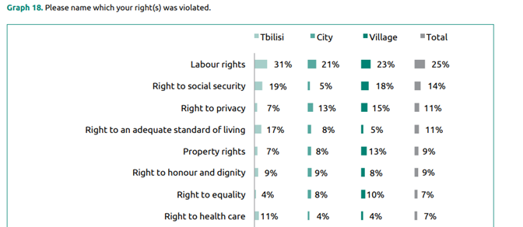
How Can Gov. Insts. Communicate Better on Human Rights?
How Can You Improve Communications?
This is what the ACT survey showed this year:

Slide 54
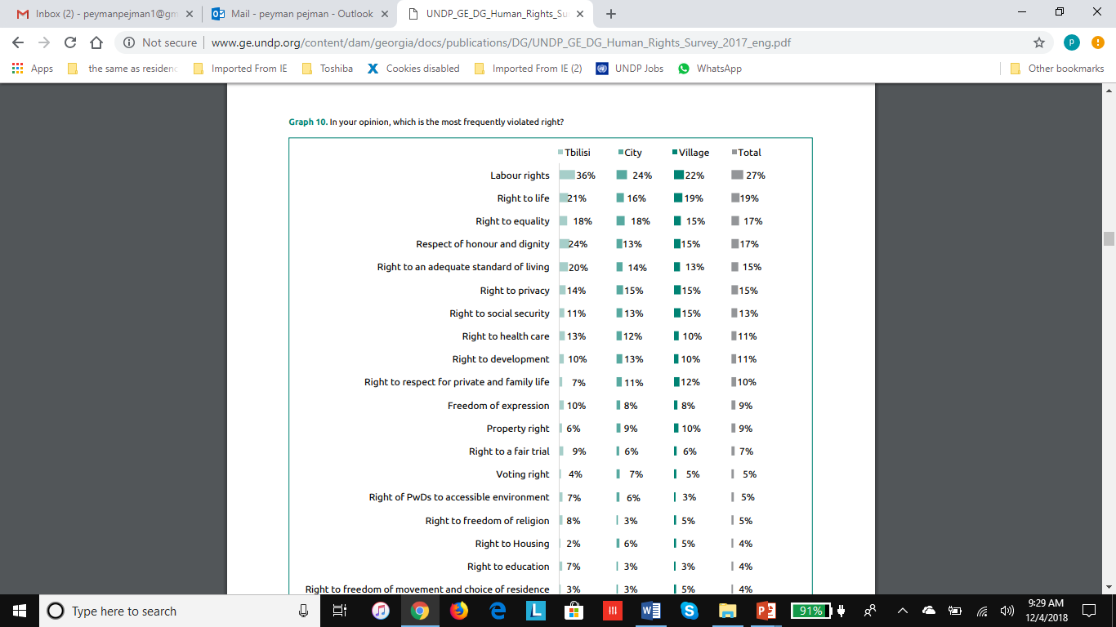
How Can Gov. Insts. Communicate Better on Human Rights?
How Can You Improve Communications?
And this is what the survey showed in 2016:

Slide 55
How Can Gov. Insts. Communicate Better on Human Rights?
How Can You Improve Communications?
Why are these concerns still the same and what does it mean it terms of how the communications operations have been carried out so far?

Slide 56
How Can Gov. Insts. Communicate Better on Human Rights?
How Can You Improve Communications?
If you look at the issues more carefully:
Labor right
Right to life
Right to equality
Right to an adequate standard of living
These are not issues that can be handled by one particular ministry of department

Slide 57
How Can Gov. Insts. Communicate Better on Human Rights?
How Can You Improve Communications?
These are nationwide, societal issues
They are NOT about ideology of a certain political party
They need multilateral efforts by several ministries and departments

Slide 58
How Can Gov. Insts. Communicate Better on Human Rights?
How Can You Improve Communications?
Therefore:
If you want to be successful in communicating that the government does really care about people’s Human Rights, you will have to look at issues from a more general perspective and create communications campaigns –not one off events like a meeting by a minister or high-ranking official.
Best if you implement them more outside Tblisi and you will have to combine media relations with outreach

Slide 59
How Can Gov. Insts. Communicate Better on Human Rights?
How Can You Improve Communications?
Incidentally, but very importantly,
Your communications partnerships should not always be with government entities!
Many NGOs and Civil Society organizations are active here, even if there is tension between some of them and some of your organizations, you have to forge better relations.
You have to establish better relations with them, as well as with the private sector!!

Slide 60
How Can Gov. Insts. Communicate Better on Human Rights?
How Can You Improve Communications?
Just as an example:
-Issues such as raising standard of living as a human rights need government-private sector coalition. As an example, according to ACT, “as of 2017, 1,422,800 people work for the private sector and 283,800 people work for the public sector.” So, only one in five employed person in the country works for the public sector

Slide 61
How Can Gov. Insts. Communicate Better on Human Rights?
How Can You Improve Communications?
Formally or informally,
Either create a communications group that meets semi-regularly and talk about issues that your ministries can/should handle
Then create a communications plan

Slide 62
How Can Gov. Insts. Communicate Better on Human Rights?
Communications Planning
Strategic Communication plan
Both the Secretariat and individual ministries need to have a strategic communication plan. That is an essential part of communications planning
While major campaigns that include series of activities and span over months should definitely have their own communications plan, ideally speaking so should short-term or one-off activities
Depending on the scope of the activity/campaign, the broader strategic communication plans and simpler communication activity plans should address the following questions:

Slide 63
How Can Gov. Insts. Communicate Better on Human Rights?
Communications Planning
Components of the plan:
-Overall Objective: Something like: “Increase the Georgians’ understanding of what their human rights are and what services the government will provide”
Target Audiences: Explain whom/why you need to reach. Be detailed. This will help you down the road, as will see shortly

Slide 64
How Can Gov. Insts. Communicate Better on Human Rights?
Communications Planning
Components of the plan:
-Goals: Identify at least one, hopefully more, goal for each target audience. Try to be as specific as possible. Example: “Decrease the percentage of people who say their labor rights are violated from 26% to 20% in the next 12 month.” You won’t have clear plans/activities if you don’t have clear goals
(This is obviously a process you’d want to go through with related ministries, but it would also serve the purpose of inter-governmental communications work, activities)

Slide 65
How Can Gov. Insts. Communicate Better on Human Rights?
Communications Planning
For Goals, try to follow the SMART formula. It will help you with measuring/reporting progress to people and government bodies
Specific (simple, sensible, significant).
Measurable (meaningful, motivating).
Achievable (agreed, attainable).
Relevant (reasonable, realistic and resourced, results-based).
Time bound (time-based, time limited, time/cost limited, timely, time-sensitive).

Slide 66
How Can Gov. Insts. Communicate Better on Human Rights?
Communications Planning
Components of the plan:
Strategy: How do you plan to achieve the goals. Depending on the case, target audience, perhaps their location, other factors, this can be broad or specific.
Example: “In coordination with ministry of labor, laws will be examined to address specific areas of concern, work with the Legislature and Judiciary bodies as needed. Corrections, adjustments, progress will be conveyed through Line Ministries, in cooperation with the Secretariat and Civil Society partners. Follow up surveys will measure improved dissatisfaction rates.”

Slide 67
How Can Gov. Insts. Communicate Better on Human Rights?
Communications Planning
Components of the plan:
Example of a specific strategy: (hypothetically) The Ministry of Displaced Persons from the Occupied Territories and Ministry of Economy will study labor laws seemed discriminatory towards the targeted population with the view of better incorporating them into the country’s economic and advance their personal and communal well-being. The ministry will invite the population to form a representative committee to discuss the measures and influence the dialogue

Slide 68
How Can Gov. Insts. Communicate Better on Human Rights?
Communications Planning
Activities: While totally modifiable, filling out this part likely requires a bit of forward thinking and multi-ministry brainstorming, as well as input from other partners. The communications plan needs to detail activities to support Goals. You need to decide whether you want to just issue a press release, how a press conference and then issue a press release, hold a town hall meeting and post the video on YouTube and Secretariat website, etc. But people need to see you working to deliver Human Rights

Slide 69

How Can Gov. Insts. Communicate Better on Human Rights?
Communications Planning
Example:
What do you see
And not see in
these pictures?
(from the Secretariat
Website on Human
Rights Day)

Slide 70
How Can Gov. Insts. Communicate Better on Human Rights?
Communications Planning
Communications Material: What do you need to produce for each activity, who will produce it, how long will it take to produce it? (Having a good calendar of events, as mentioned, will come very handy with this!!)
Cost: You are not flush with money, doing this planning exercise will help you determine what will each event cost, and adjust activities, material, as needed

Slide 71
How Can Gov. Insts. Communicate Better on Human Rights?
Communications Planning
Lastly: Think of ways to measure the impact. You need to be able to show that your communications plans and activities have had positive impact and people feel more comfortable about the Human Rights situation in the country

Slide 72
How Can Gov. Insts. Communicate Better on Human Rights?
Integrated Communication
What is integrated communication?
Integrated communication is a concept that was first introduced in commercial marketing to make sure that all the communication forms and the messages are interrelated and work together in harmony
Integrated Communication as Strategic Communication, Review of International Comparative Management Volume 16, Issue 4, October 2015

Slide 73
How Can Gov. Insts. Communicate Better on Human Rights?
Integrated Communication
Organizations, whether private sector or governments, make two almost-universal mistakes:
1-There is an over-reliance on social media. Putting out multi-tweets or post on Facebook does not help you reach all your needed audiences
2-Produce content and disseminate with disregard for the type-nature of audiences they need to cater to. That means the content is “one-size-fits-all.” Don’t put “success” stories only on FB, Twitter. Why?

Slide 74
How Can Gov. Insts. Communicate Better on Human Rights?
Integrated Communications
Will discuss integrated communications and using print and broadcast media more in later slides. But for now:
You should use social media in close coordination with the IT people because you should regularly monitor the statistics of who/from where people access your sites
Analyzing where they come from, what they read, what they click on, how much time they spend, where they go next on the site give you valuable information on whom you are reaching and what content to produce

Slide 75
How Can Gov. Insts. Communicate Better on Human Rights?
A Few Words on Increasing Exposure
--Talked in previous slides about social media and integrated communication
--Television and radio are primarily sources of information
-- Although they are not as accessible as they should be
A)There are ways around it
B)They are not the only sources for getting exposure for what government does

Slide 76

How Can Gov. Insts. Communicate Better on Human Rights?
A Few Words on Increasing Exposure

Slide 77
How Can Gov. Insts. Communicate Better on Human Rights?
A Word About Increasing Exposure
A few figures are interesting:
-- TV numbers DECREASED from 88% to 82%
--Social media and news portals INCREASED from 30% to 48%
--Radio has DECREASED BY HALF from 4% to 2%
--Access through government websites has remained the same, 2%

Slide 78
How Can Gov. Insts. Communicate Better on Human Rights?
A Few Words About Increasing Exposure
To inevitable conclusions!
TV is the 800-pound gorilla in the room!!
(You need to find ways to work with it)
Social media is an opportunity that 1)not to be missed; but also 2)used properly

Slide 79
How Can Gov. Insts. Communicate Better on Human Rights?
A Few Words About Increasing Exposure
TV
TV Stations care about two things:
Viewership (rating)
Advertising (resulting from viewership)
In Georgia, while advertising money might be limited, TV stations desire for having/maintaining high viewership is nevertheless paramount. It’s the nature of the business

Slide 80
How Can Gov. Insts. Communicate Better on Human Rights?
A few Words About Increasing Exposure
Viewership
Given the relationship between media ownership and politics in Georgia, you need to do two things:
--As mentioned earlier, make human rights a national/societal issue, not one tied to a specific government
--Make Human Rights about people, not topics. Topics are important but they need to be presented answering, “How does it benefit ‘me,’ a citizen?” Then TV stations will come!

Slide 81
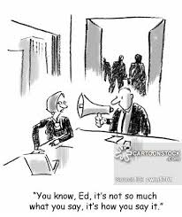
How Can Gov. Insts. Communicate Better on Human Rights?
A Few Words About Increasing Exposure

Slide 82
How Can Gov. Insts. Communicate Better on Human Rights?
A Few Words About Increasing Exposure
So how can we change the dynamics of working with TVs
--Suggest “human interest stories” that “show” progress
--Put people upfront, not officials
--If you have to put them, insert them into the agenda of programs that matter to people
Women’s programs; Children’s programs; Game shows;
Cooking shows!!

Slide 83
How Can Gov. Insts. Communicate Better on Human Rights?
A Few Words About Increasing Exposure
So how can we change the dynamics of working with TVs
--Think also of stories that can show progress outside the capital
(it’s an ego thing for most station owners! They want to show they have nationwide following!)
--If TV stations don’t take an idea on first try, pitch them again once it’s been published somewhere else, even if it on your own website
(often, a produced story looks more attractive than the “just an idea” you first presented)

Slide 84
How Can Gov. Insts. Communicate Better on Human Rights?
A Few Words About Increasing Exposure
So how can we change the dynamics of working with TVs
--First, try to organize more “outreach” events: townhall meetings, (rather informal) gatherings between state and local officials and communities. The have communications merits on their own
--Second, invite TV stations to those. They are more attractive than a minister or deputy talking. Arrange for the reporter to talk to members of the community, even if they complain!

Slide 85
How Can Gov. Insts. Communicate Better on Human Rights?
A Few Words About Increasing Exposure
But if TV does not work, it’s not the end of the world!!
Concentrate on two other media
--Social Media (some idea of might be attractive:
--Using public outreach platform and tools
billboards, posters, creating your own YouTube-style video clips, distributing either through YouTube or “mobile cinemas” locally, or distribute through DVDs, flash disks

